Slide 1

ITLPA701: PYTHON AND FUNDAMENTALS OF AI
January 20, 2025
LEARNING UNIT 2–DEVELOP PYTHON CONCEPT
Mr. Etienne NTAMBARA
ntambaraienne94@gmail.com
Assistant Lecturer in ICT Department
Rwanda Polytechnic, IPRC-HUYE
Homepage: https://94etienne.github.io/profile/
Learning hours: 9

Slide 2
Content
Learning Outcome 1.1: Identify Python Version
Definition of terms
Characteristic of python
Application of python

Slide 3
Content
Learning Outcome 1.2: Add python directory
Local Environment set up
Getting python set up
Set up path

Slide 4
Content
Learning Outcome 1.3: Identify Library
Definition of key terms
Identification of problem
Getting library

Slide 5
1.1: Identify Python Version
Definition of terms
Python: is a programming language commonly used for developing websites and software, task automation, data analysis, and data visualization. Key features of Python include: Readability, Interpretation, Object-Oriented, Dynamic Typing and Extensive Standard Library.

Slide 6
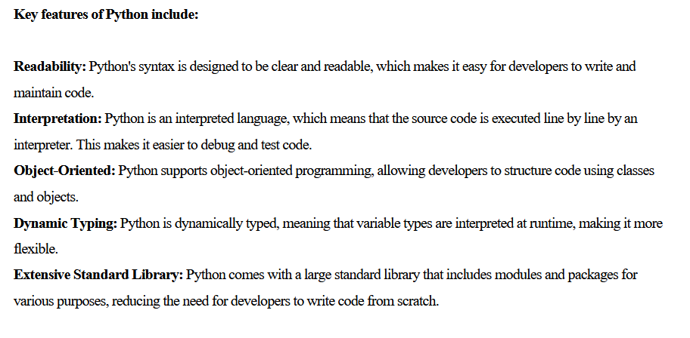
1.1: Identify Python Version
Definition of terms

Slide 7
1.1: Identify Python Version
Definition of terms
Programming language: a programming language is a formalized set of instructions that a computer can interpret and execute to perform specific tasks or operations.
Key characteristics of programming languages include: Syntax, Semantics, Abstraction, Variables and Data Types, Control Structures, Functions or Procedures, Libraries and Frameworks.

Slide 8
1.1: Identify Python Version
Definition of terms
Use of python
Server: Python is used for server-side scripting, allowing developers to embed Python code within web pages or server-side scripts to create dynamic content.
Software development: Python is often used to develop the back end of a website or application.
Python offers several frameworks for web development. Commonly used ones include Django and Flask.

Slide 9
1.1: Identify Python Version
Definition of terms
Use of python
3. Mathematics
Python is a powerful programming language that is widely used in various fields, and mathematics is no exception.
Python provides extensive support for mathematical operations and computations through built-in functions, libraries, and modules.
4. System scripting: A script, in the context of computer programming, refers to a set of instructions or commands written in a
scripting language that is executed by a computer. This means that the script's instructions are executed line by line by an interpreter or runtime environment.

Slide 10
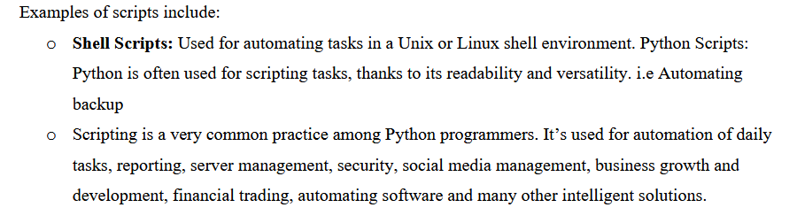
1.1: Identify Python Version
Definition of terms
Use of python
Examples of scripts include:

Slide 11
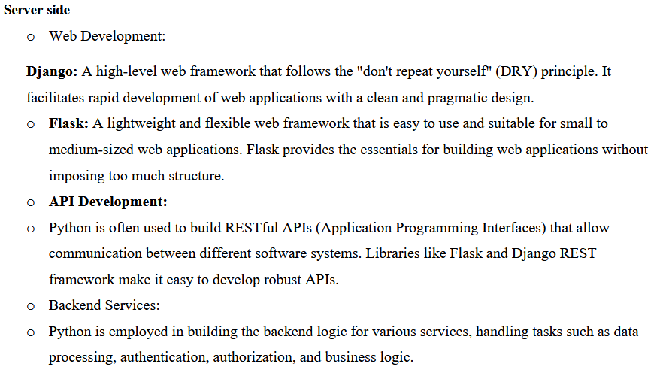
1.1: Identify Python Version
Definition of terms
Use of python
Examples of scripts include:

Slide 12
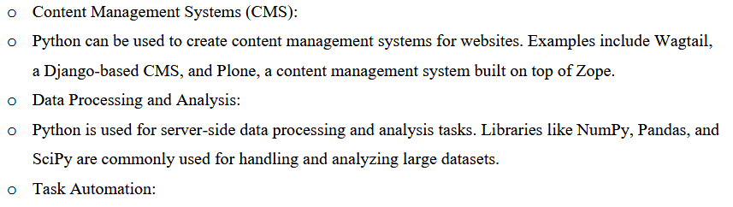
1.1: Identify Python Version
Definition of terms
Use of python
Examples of scripts include:

Slide 13
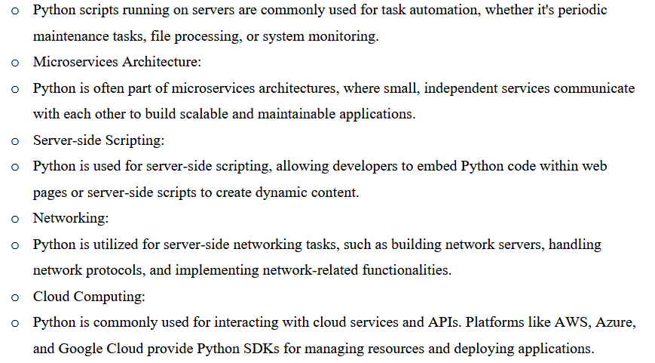
1.1: Identify Python Version
Definition of terms
Use of python
Examples of scripts include:

Slide 14
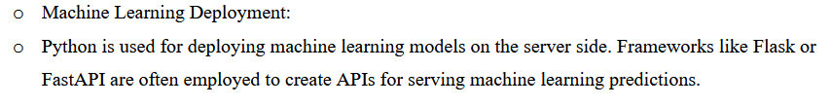
1.1: Identify Python Version
Definition of terms
Use of python
Examples of scripts include:

Slide 15
1.1.2 Characteristic of python
Python is a versatile programming language known for its simplicity, readability, and flexibility.
Here are some key characteristics of Python:
Readable and Simple Syntax: Python emphasizes readability and a clean syntax, making it easy for developers to express concepts with fewer lines of code. This readability is supported by the use of indentation to define code blocks.
Interpreted Language: Python is an interpreted language, meaning that the source code is executed line by line by an interpreter at runtime. This allows for quick testing and debugging.

Slide 16
1.1.2 Characteristic of python
High-Level Language: Python is a high-level programming language, abstracting low-level details and providing a more straightforward and human-readable syntax. This makes it accessible for beginners and efficient for experienced developers.
Object-Oriented Programming (OOP): Python supports object-oriented programming, allowing developers to structure code using classes and objects. Encapsulation, inheritance, and polymorphism are fundamental concepts in Python's OOP paradigm.
Dynamic Typing: Python is dynamically typed, meaning that the data type of a variable is interpreted at runtime. This provides flexibility but requires careful attention to variable types during development.

Slide 17
1.1.2 Characteristic of python
Cross-Platform Compatibility: Python code is generally platform-independent. A Python program written on one operating system (e.g., Windows) can run on another (e.g., Linux) with minimal or no modifications.
Extensive Standard Library: Python comes with a comprehensive standard library that includes modules and packages for various tasks. This eliminates the need for developers to write code from scratch for common functionalities.
Integration Capabilities: Python can easily integrate with other languages and technologies, making it a popular choice for building complex and integrated systems. It supports interfacing with C, C++, and Java, among others.

Slide 18
1.1.3 Application of python
Based on Flexibility:
Web Development: Python's frameworks like Django and Flask make it flexible for creating web applications of varying complexity.
Automation and Scripting: Python's simplicity and adaptability make it highly flexible for scripting tasks and automating workflows.
Scientific Computing: Python's libraries like SciPy and Matplotlib provide flexibility for performing various scientific tasks, from visualization to numerical analysis.
Embedded Systems: Python's lightweight frameworks make it suitable for programming embedded systems and IoT devices

Slide 19
1.1.3 Application of python
Based on Audience:
Data Science and Machine Learning: Targeted towards data scientists, researchers, and AI engineers who rely on Python's libraries like NumPy, Pandas, Scikit-learn, and TensorFlow.
Game Development: Primarily for game developers and hobbyists using libraries like Pygame.
Network Programming: Designed for network engineers and developers creating tools and applications for network systems.
Desktop GUI Applications: Geared towards developers building user-friendly desktop applications for end-users.

Slide 20
1.1.3 Application of python
Based on Prerequisite:
Web Development: Requires knowledge of web technologies like HTML, CSS, JavaScript, and server-side scripting.
Data Science and Machine Learning: Requires a basic understanding of mathematics, statistics, and machine learning concepts.
Scientific Computing: Assumes knowledge of numerical methods and data visualization techniques.
Game Development: Requires understanding of game mechanics and design principles.
Network Programming: Requires knowledge of networking protocols and systems.
Desktop GUI Applications: Assumes familiarity with event-driven programming and GUI design.
Embedded Systems: Requires knowledge of hardware interfaces and low-level programming.

Slide 21
QUIZ
Duration Five minutes

Slide 22
1.2 Add python Directory
1.2.1 Local Environment set up
Setting up a local development environment for Python involves installing the necessary tools and libraries on your computer.
Here are the general steps for setting up a Python environment on your local machine:
1.2.1.1 Windows
Steps to Install Python on Windows:
1. Download Python Installer:
Go to the https://www.python.org/downloads/
Click on the "Download Python" button for the latest version suitable for Windows.

Slide 23
1.2 Add python Directory
2. Run the Installer:
Locate the downloaded installer (usually in the Downloads folder) and double-click to run it.
3. Select Installation Options:
Important: Check the box labeled "Add Python to PATH" to ensure Python is accessible from the command line.
Click on "Customize Installation" if you want to modify default options, or simply choose "Install Now" for the standard setup.
4. Customize Installation (Optional):
In the customization window, select optional features like pip (Python's package manager), IDLE (Python's development environment), and others.
Choose the destination folder if you don't want the default location.

Slide 24
1.2 Add python Directory
5. Wait for Installation to Complete:
The installer will copy files and set up Python on your system. This may take a few minutes.
6. Verify Installation:
Open a Command Prompt or PowerShell and type:
python –version or
python –V
7. Choose an editor you want to use like: vscode, pycharm, sublime, jupyter notebook, jupyter lab, atom.
8. Write your python codes with .py or .ipnb extension file.

Slide 25
1.2 Add python Directory
1.2.1.2 Linux/Unix (CentOS 7/Redhat/SUSE/UBUNTU)
1.2.1.3. Installation on Mac OS
Read lecture from page 16-17

Slide 26
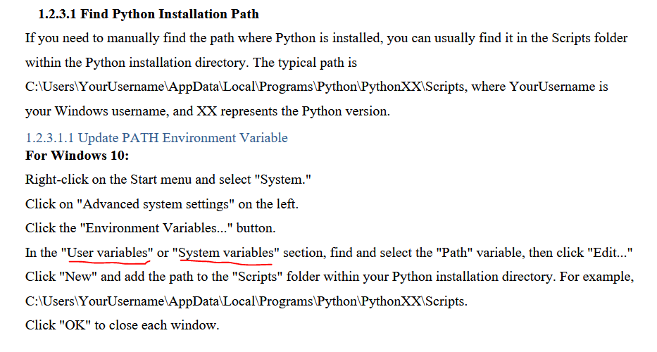
1.2 Add python Directory
1.2.2 Set up path: https://youtu.be/91SGaK7_eeY?si=s0zpCN60m6jSgNbh

Slide 27
1.2 Add python Directory
User Variables: Application is accessed only by that user
System Variables: Application is accessible that all users of that system
1.2.3.2 Running python
Interactive Interpreter You can start Python from Unix, DOS, or any other system that provides you a commandline interpreter or shell window. Enter python the command line

Slide 28
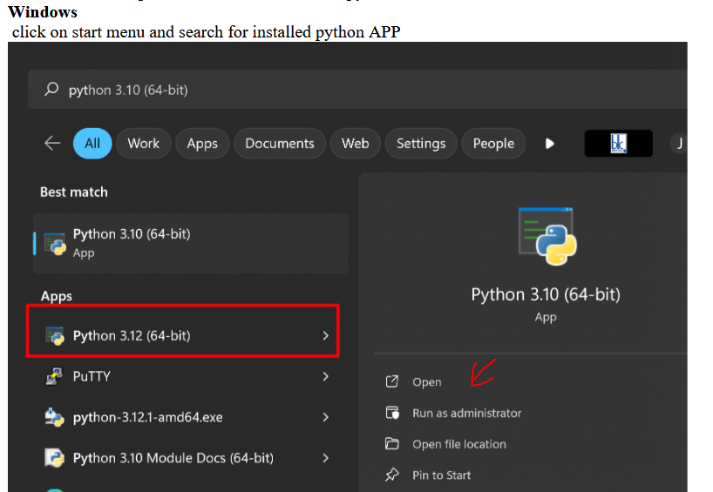
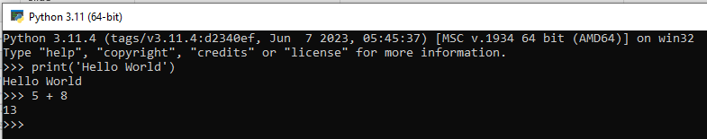

Slide 29
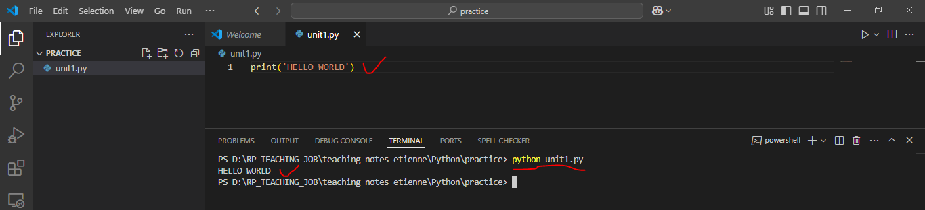
1.2 Add python Directory
1.2.3.3 Integrated Development Environment(IDE) or GUI
Integrated Development Environment You can run Python from a Graphical User Interface (GUI) environment as well, if you have a GUI application on your system that supports Python.
To run python file: python filename.py

Slide 30
QUIZ (PRACTICE) / 5 marks
15 minutes

Slide 31
1.3 Identify library
1.3.1 Definition of key terms
1.3.1.1 Library
A Python library is a collection of modules and functions that allow you to perform specific tasks or implement certain functionalities in your Python programs
Libraries are pre-written code that you can reuse in your own projects, saving you time and effort by not having to write everything from scratch.
Python has a rich ecosystem of libraries that cover a wide range of domains, such as data science, machine learning, web development, networking, graphics, and more. These libraries are typically distributed as packages and can be easily installed using tools like pip, which is the default package installer for Python.

Slide 32
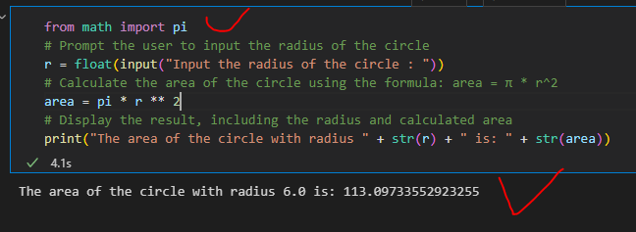
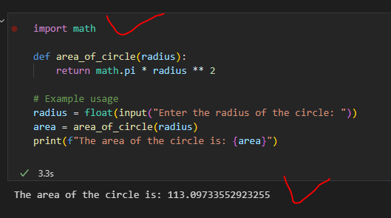
1.3.1.1 Library
Ex: Compute area of a circle

Slide 33
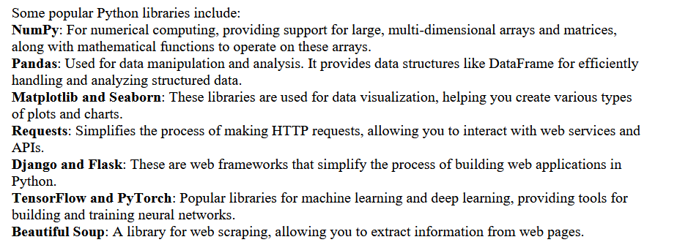
1.3.1.1 Library

Slide 34
1.3.1.2 Package
When developing a large application, you may end up with many different modules that are difficult to manage. In such a case, you’ll benefit from grouping and organizing your modules. That’s when packages come into play.
To be considered a package (or subpackage), a directory must contain a file named __init__.py. This file
usually includes the initialization code for the corresponding package.
1.3.1.3 Import
In Python, the “import” statement is used to bring in external modules or libraries into your program. This allows you to use the functions, classes, and variables defined in those modules within your own Python script or program.

Slide 35
1.3.1.3 Import
There are several ways to use the import statement:
Basic Import
# import module_name
import pandas
2. Import with alias
# import module_name as alias_name
import pandas as pd
3. Import Specific Items:
# from module_name import item_name
from math import pi

Slide 36
1.3.1.3 Import
There are several ways to use the import statement:
4. Import Everything:
# from module_name import *
from math import *
1.3.1.4 Module
A Python module is a file containing Python definitions and statements. A module can define functions, classes, and variables. A module can also include runnable code. Grouping related code into a module
makes the code easier to understand and use. It also makes the code logically organized.

Slide 37
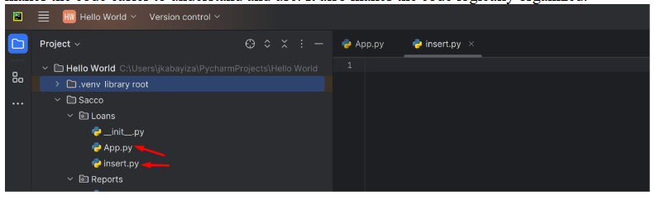
1.3.1.4 Module

Slide 38
1.3.1.5 PIP
Pip is a package manager that is used to install and manage software packages and modules found in the Python Package index or any other indexes.

Slide 39
1.3.2 Identification of problem
HR added unwanted feature called heart rate during employee registration.
Please prepare your own employee dataset with those feature (Name, Age, Salary, heart rate payment status) add 20 random records from after dataset preparation keep it in data frame drop heart rate feature then store final dataset into csv file.

Slide 40
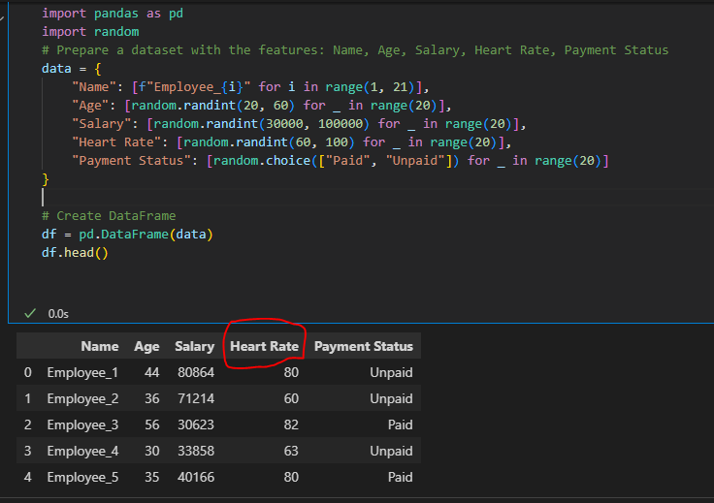
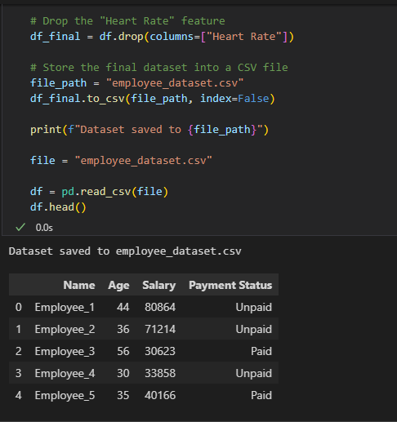
SOLUTION: In the statement import pandas as pd, the pd is an alias or shorthand name for the pandas library. It is commonly used in Python programming to save time when writing code and to improve readability.

Slide 41
1.3.3 Getting a library
1.3.2.1 Install PIP
Check if it is installed: in cmd type=> pip –version
If PIP is already installed, you’ll see its version information.
Step 2: Download the get-pip.py script (if PIP is not installed)
https://bootstrap.pypa.io/get-pip.py
Download the get-pip.py file and save it to a convenient location, such as your Desktop.

Slide 42
1.3.3 Getting a library
Step 3: Install PIP using the get-pip.py script
1. Open the Command Prompt.
2. Navigate to the directory where you downloaded the get-pip.py file. For example: cd Desktop
3. Run the following command to install PIP: python get-pip.py
Step 4: Verify the installation
Once the script finishes running, check if PIP was installed successfully:
pip –version
Step 5: Add PIP to the system PATH (if needed)

Slide 43
1.3.3 Getting a library
Step 5: Add PIP to the system PATH (if needed)
If the pip command is not recognized, you may need to add it to your system's PATH:
Locate the Scripts folder inside your Python installation directory (e.g., C:\PythonXX\Scripts).
Add the folder to your PATH environment variable:
Right-click This PC or My Computer → Properties → Advanced System Settings → Environment Variables.
Under System Variables, select Path → Edit → New, and add the path to the Scripts folder.

Slide 44
1.3.3 Getting a library
Step 6: Update PIP (optional but recommended)
Run the following command to update PIP to the latest version:
pip install --upgrade pip

Slide 45
1.3.2.2 Download and Install Library
To download a Python library, you typically use a package manager, and pip is the most common one for Python. To download and install a Python library using pip, you can use the following command in your terminal or command prompt:
pip install library_name
Example: Install Django Library: pip install Django
1.3.2.3 Import library
To import the Django library in Python, you use the import statement. Django is a web framework for building web applications using Python. If you have Django installed, you can import it into your Python
script or project like this:
# Importing Django
import django
# Now you can use Django functionality in your script
print(django.get_version())

Slide 46
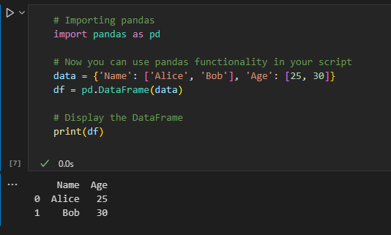
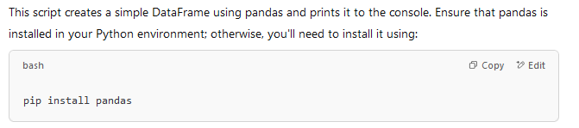
Pandas
To import the pandas library in Python, you use the import statement. Pandas is a powerful library for data manipulation and analysis in Python. If you have Pandas installed, you can import it into your Python script or project like this:

Slide 47
Additional
Do your own research on how to set python virtual environment and try to do some practices into your created environment.
Reference: https://www.youtube.com/watch?v=XKS1mulk7AQ

Slide 48
Quiz 5 marks
5 minutes

Slide 49
Q &A
Thanks
Unit ends

